Slide 1
Differential Equations
Separable Equations, Integrating Factors

Slide 2
Differential Equations
Differential equations are equations that are specified in terms of a rate of change that depends on the current value.
Many physical processes can be written like this. A typical example is a puddle evaporating. The larger the surface area, the faster it evaporates. But the more it evaporates, the smaller it’s surface area!

Slide 3
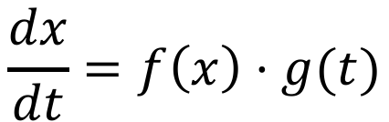
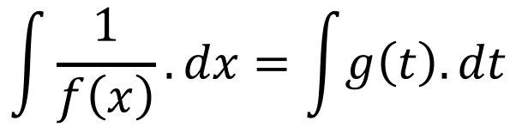
Separable Differential Equations
These are your “basic” differential equations, and are exactly the kind you will see in Year 13.
All take the form
… and can be rearranged to be solved as
$$\frac{dx}{dt}=f\left(x\right)⋅g(t)$$
$$\int{\frac{1}{f\left(x\right)}.dx}=\int{g\left(t\right).dt}$$

Slide 4
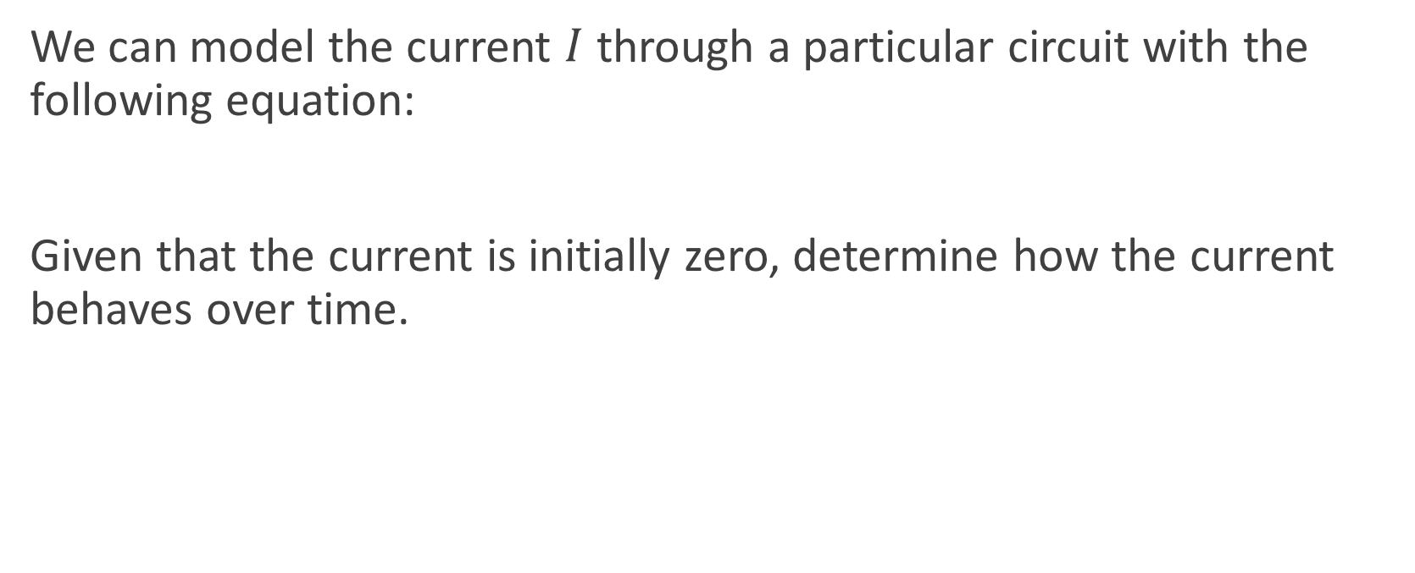


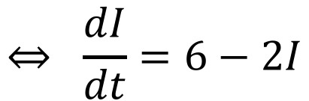
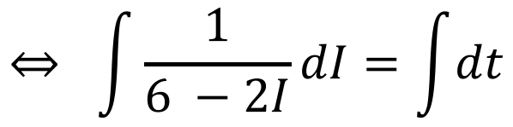
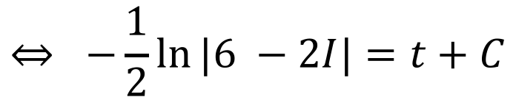
Example
We can model the current $I$ through a particular circuit with the following equation:
Given that the current is initially zero, determine how the current behaves over time.
$$2\frac{dI}{dt}+4I=12$$
$$2\frac{dI}{dt}+4I=12$$
$$⇔ \frac{dI}{dt}=6−2I$$
$$⇔ \int{\frac{1}{6 −2I}}dI=\int{dt}$$
$$⇔ −\frac{1}{2}\ln{|6 −2I|}=t+C$$

Slide 5

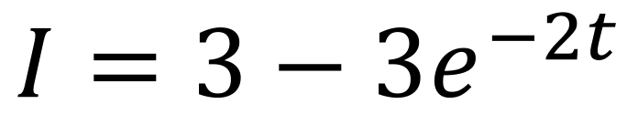
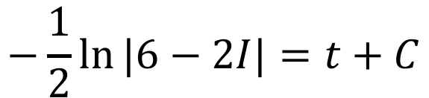



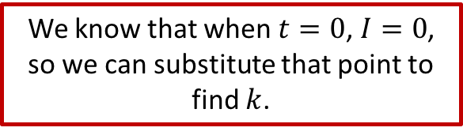



Example
We know that when $t=0$, $I=0$, so we can substitute that point to find $k$.
$$−\frac{1}{2}\ln{|6−2I|}=t+C$$
$$0=3−ke^{−2×0}$$
$$⇔0=3−ke^{0}$$
$$⇔\ln{|6−2I|}=−2t+C$$
$$⇔0=3−k$$
$$⇔6−2I=e^{−2t+C}=e^{−2t}e^{C}=ke^{−2t}$$
$$⇔k=3$$
$$⇔−2I=ke^{−2t}−6$$
$$I=3−3e^{−2t}$$
$$⇔I=3−ke^{−2t}$$

Slide 6
Integrating Factors
Sometimes we get stuck with an equation that we can’t separate. When we get this, we need to find some way to make it work by multiplying by the same factor on both sides of the equation.
What do we multiply by? It’s called the ”integrating factor”, and takes a particular form which we will see on the next slide.

Slide 7
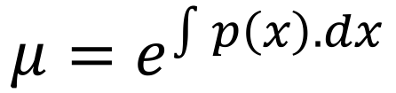
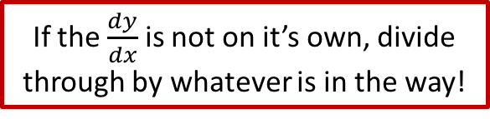
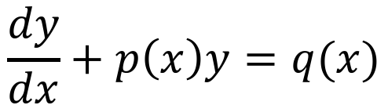
Integrating Factors
If the $\frac{dy}{dx}$ is not on it’s own, divide through by whatever is in the way!
Given an inseparable differential equation in the form
the integrating factor is
But why does that work?
$$\frac{dy}{dx}+p\left(x\right)y=q(x)$$
$$μ=e^{\int{p\left(x\right).dx}}$$

Slide 8
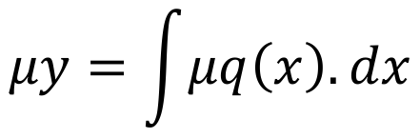
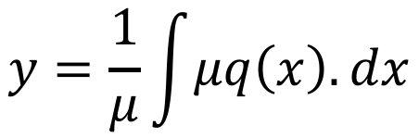
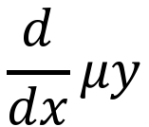
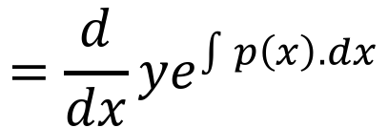
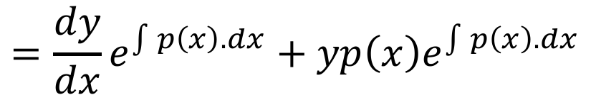
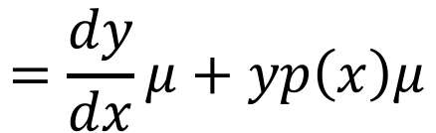
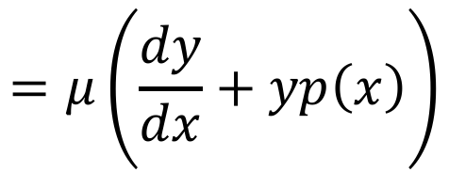

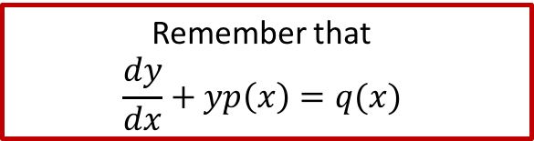
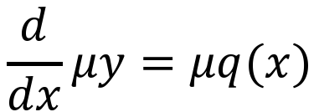
Integrating Factors
Remember that
$$\frac{dy}{dx}+yp\left(x\right)=q(x)$$
Consider the function $μy$
$$\frac{d}{dx}μy$$
$$=\frac{d}{dx}ye^{\int{p\left(x\right).dx}}$$
$$\frac{d}{dx}μy=μq(x)$$
$$μy=\int{μq\left(x\right).dx}$$
$$=\frac{dy}{dx}e^{\int{p\left(x\right).dx}}+yp\left(x\right)e^{\int{p\left(x\right).dx}}$$
$$y=\frac{1}{μ}\int{μq\left(x\right).dx}$$
$$=\frac{dy}{dx}μ+yp\left(x\right)μ$$
$$=μ\left(\frac{dy}{dx}+yp\left(x\right)\right)$$
This can now be solved by integration.
$$=μq(x)$$

Slide 9
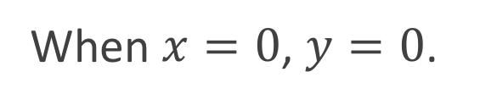
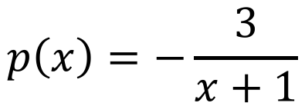
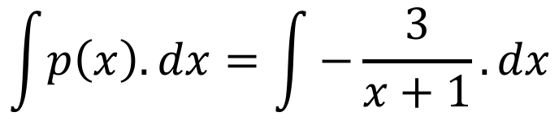



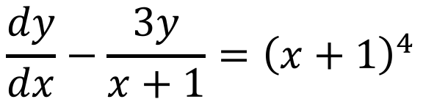
Example
$$\frac{dy}{dx}−\frac{3y}{x+1}={\left(x+1\right)}^{4}$$
When $x=0$, $y=0$.
$$p\left(x\right)=−\frac{3}{x+1}$$
$$q\left(x\right)={\left(x+1\right)}^{4}$$
$$\int{p\left(x\right).dx}=\int{−\frac{3}{x+1}.dx}$$
$$=−3ln{|x+1|}$$
$$μ=e^{−3ln{|x+1|}}={\left(x+1\right)}^{−3}$$

Slide 10
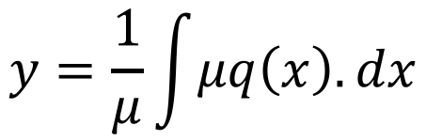

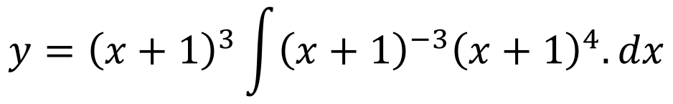
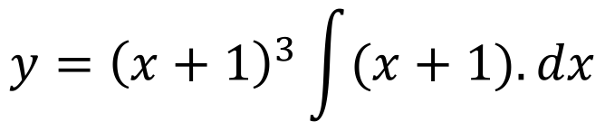
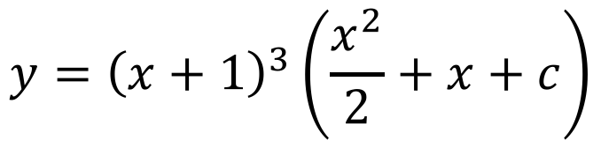

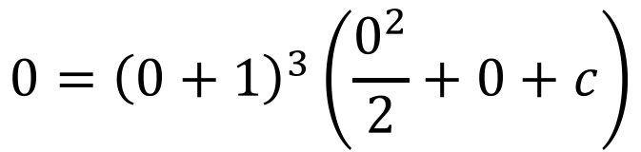

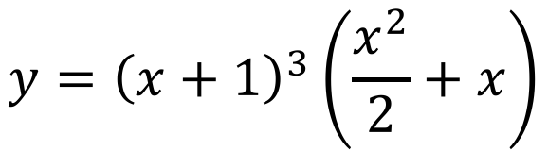

Example
Remember when
$x=0$, $y=0$
$$y=\frac{1}{μ}\int{μq\left(x\right).dx}$$
$$μ={\left(x+1\right)}^{−3}$$
$$q\left(x\right)={\left(x+1\right)}^{4}$$
$$y={\left(x+1\right)}^{3}\int{{\left(x+1\right)}^{−3}{\left(x+1\right)}^{4}.dx}$$
$$0={\left(0+1\right)}^{3}\left(\frac{0^{2}}{2}+0+c\right)$$
$$y={\left(x+1\right)}^{3}\int{(x+1).dx}$$
$$0=c$$
$$y={\left(x+1\right)}^{3}\left(\frac{x^{2}}{2}+x\right)$$
$$y={\left(x+1\right)}^{3}\left(\frac{x^{2}}{2}+x+c\right)$$

Slide 11
Do Now
Any Questions?
Delta Workbook
Exercises 24.1–24.3, 25.1-25.2, Extension Exercise 25
Workbook
Pages 182-184, 186-189

Slide 12

This work is licensed under a Creative Commons Attribution-NonCommercial-ShareAlike 4.0 International License.
Aaron Stockdill
2016

